Slide 1


Final presentation
Which pathways are affected by induction with methyl-jasmonate and ethylene?
The Periwinkles

Slide 2
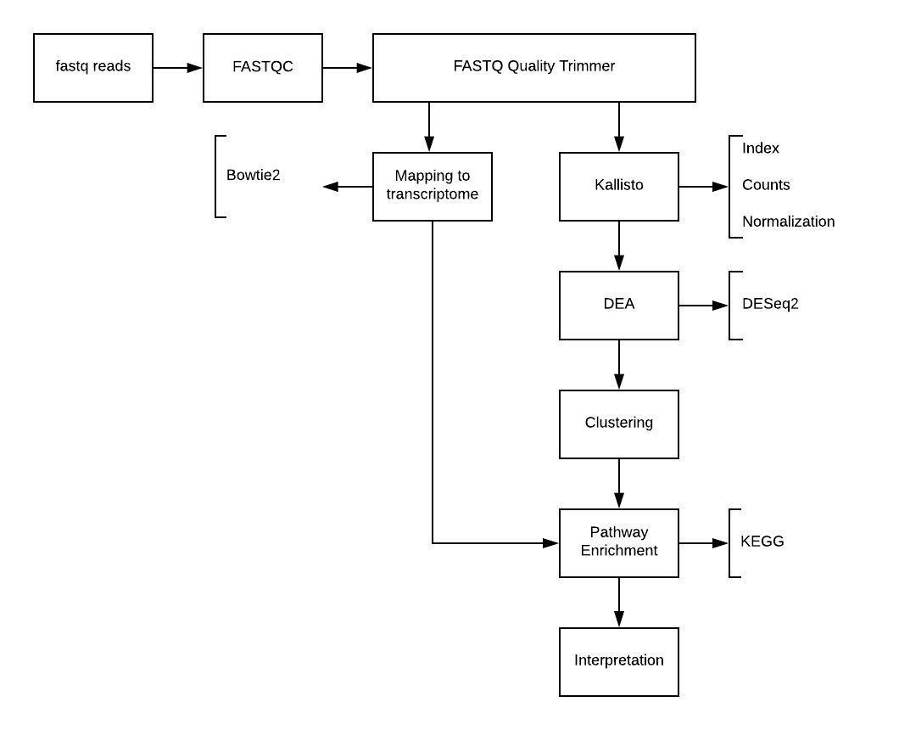
Which pathways are affected by induction with methyl-jasmonate and ethylene?
Our musts:
Read quality
Read trimming
Genome Mapping
Transcriptome identification
Differential expression analysis
Gene clustering
Identify pathways
Enrichment analysis
Project flow

Slide 3
Which pathways are affected by induction with methyl-jasmonate and ethylene?
Our shoulds:
We should compare our results with the papers
Predict biosynthetic pathway gene clusters using Plantismash with genomes V1 and V2
Find missing genes in the pathway
Compare the behaviour of differential expression with the different cultures

Slide 4
Data
From Pan et al. (2018):
Catharanthus roseus seedlings, control, 3 replicates
Catharanthus roseus seedlings, methyl jasmonate treatment, 3 replicates
Catharanthus roseus seedlings, ethylene treatment, 3 replicates Only forward reads!
From Franke et al. (2018):
Transcriptome
After bad DEA results:
Catharanthus roseus seedlings, control → 3 2 replicates

Slide 5
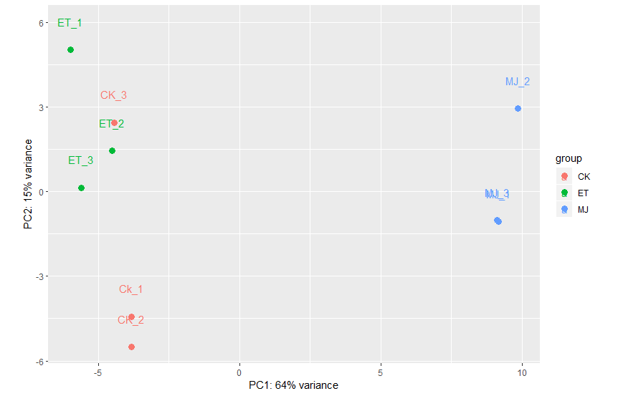
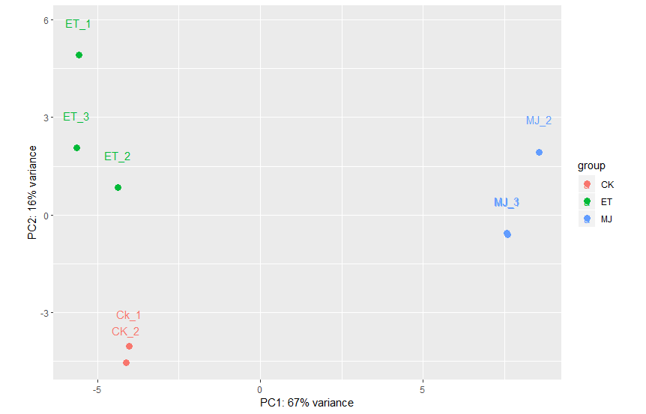
Control replicate 3
Before After
Notes:
Principal Component Analysis (PCA) of the samples before and after removing CK3. PCA tries to explain the variance in the dataset. Here it shows that the largest variance (PC1, horizontal) is between the control CK and methyl-jasmonate MJ. The second largest variance (PC2, vertical) is between control CK and ethylene ET.
The initial PCA shows a very weird spot for CK3: it has little variance with ET and a lot with its actual assigned group: CK. We think it might be mislabelled (and actually be an ET sample) or something went wrong during sample taking, sequencing, or anything else where errors can occur. We removed CK3 from our dataset (slightly reducing balance as CK only has 2 samples now) and found a lot better distinction between CK and ET: it is more in line with the expectancy that ET affects pathways in Catharanthus roseus. It might introduce some bias as we shape the data a bit, but we think it is warranted given the now clear distinction between the conditions.

Slide 6
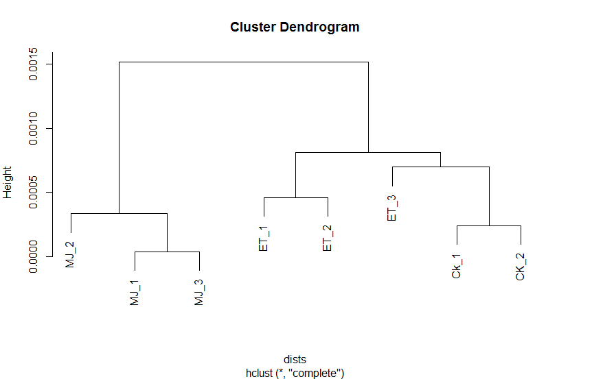
Differential Expression Analysis (DESeq2)
?
Notes:
While doing the clustering we find that The horizontal axis of the dendrogram represents the replicates and clusters and the vertical axis represents the distance or dissimilarity between clusters. Here we can say that replicate 3 is not part of ET nor Control cluster due to its distance between them. However, according to the PCA all the ET replicates are grouped together.

Slide 7
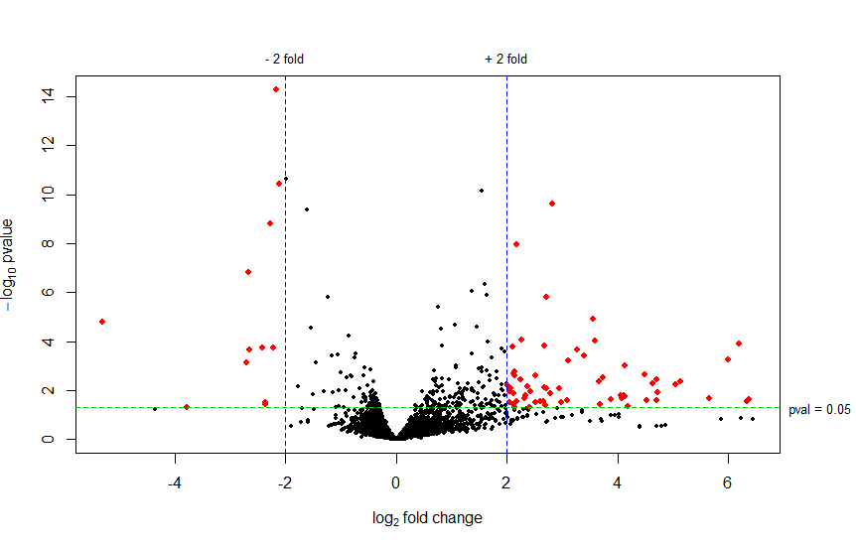
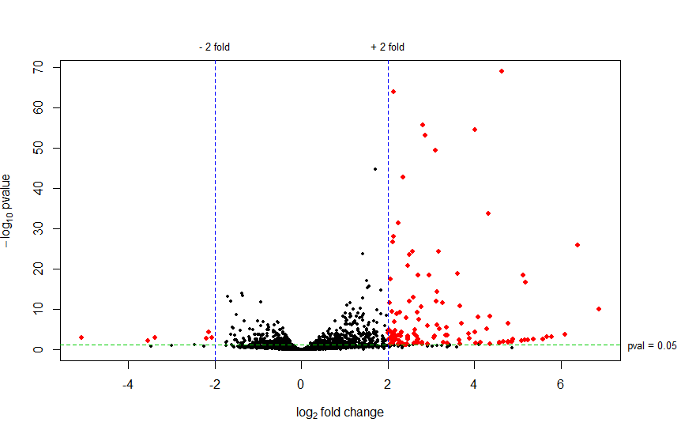
Volcano plots
CK vs. ET CK vs. MJ
Notes:
While doing the Volcano plots we can see the analysis between the log fold change versus the significance (log p-value). Horizontal: the further from the center, the higher the fold change. Vertical: the higher, the more significant (lower p-value).
Most notable is that MJ seems to affect a lot more genes significantly than ET, and also seems to downregulate less genes than ET. More genes in MJ are also a lot more significantly different than ET (see y-axis difference).

Slide 8
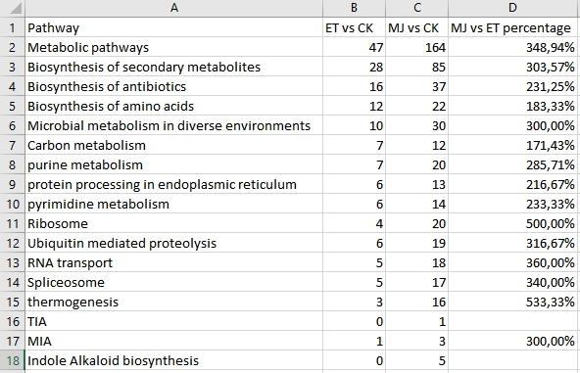
Pathway analysis
Notes:
Which pathways are influenced by treatment with MJ & ET??
We can see that in each pathway, the number of DEG's with MeJA treatment was considerably bigger than with ET treatment. We can say that the pathways are more sensitive to MeJA than to ET.

Slide 9
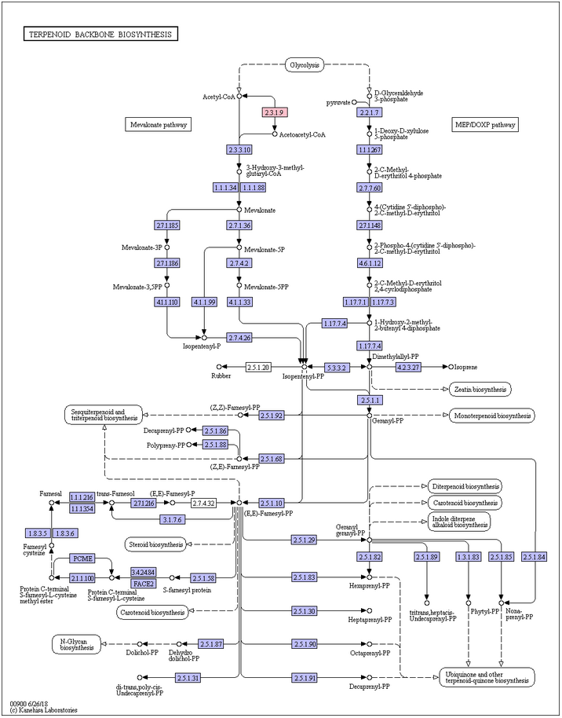
TIA pathway
MJ
Notes:
Only found in methyl-jasmonate

Slide 10
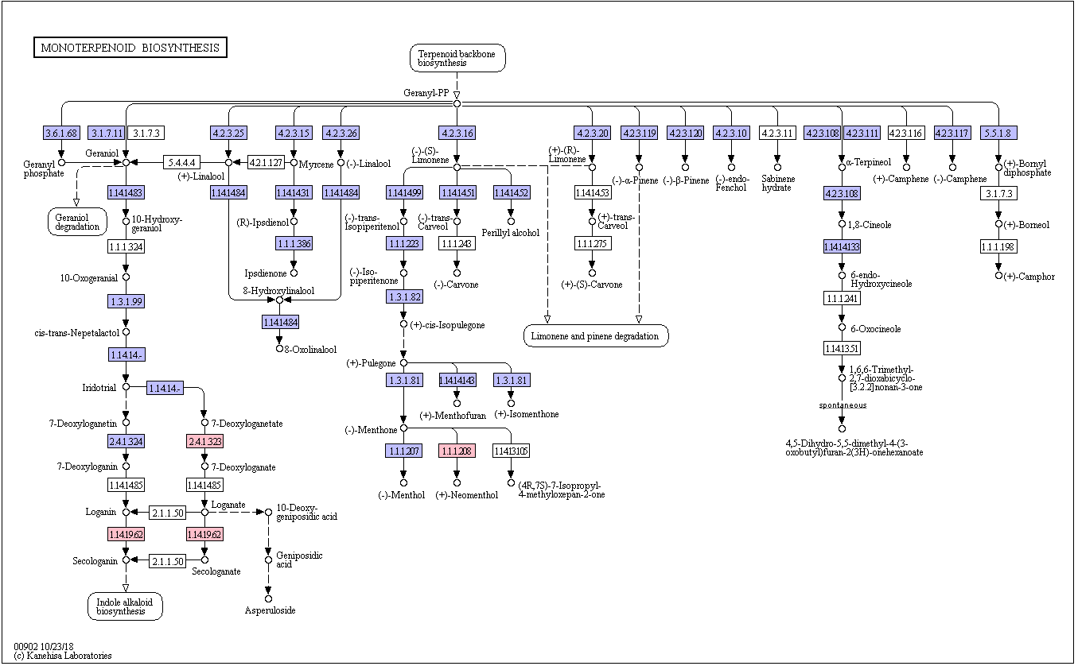
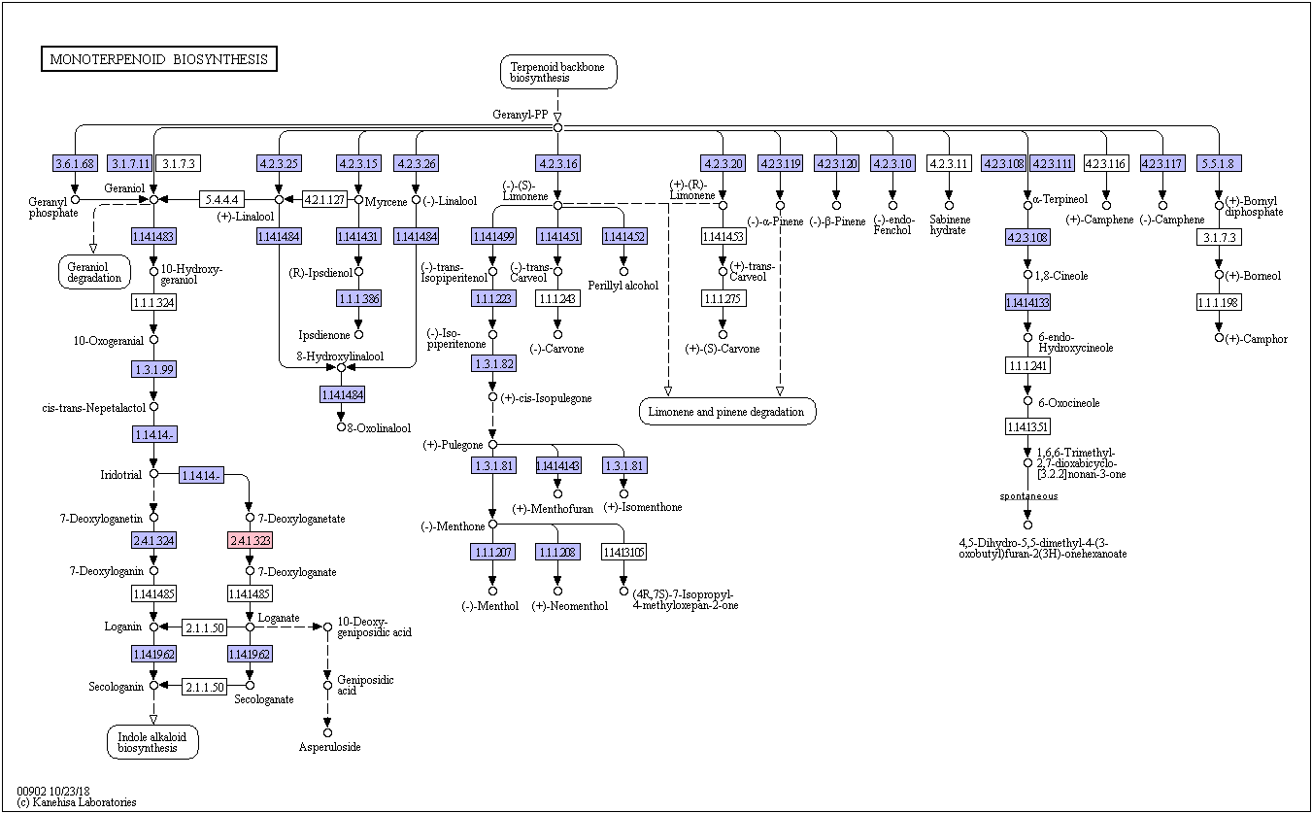
MIA pathway
ET
MJ
Notes:
MJ: right
ET: left

Slide 11
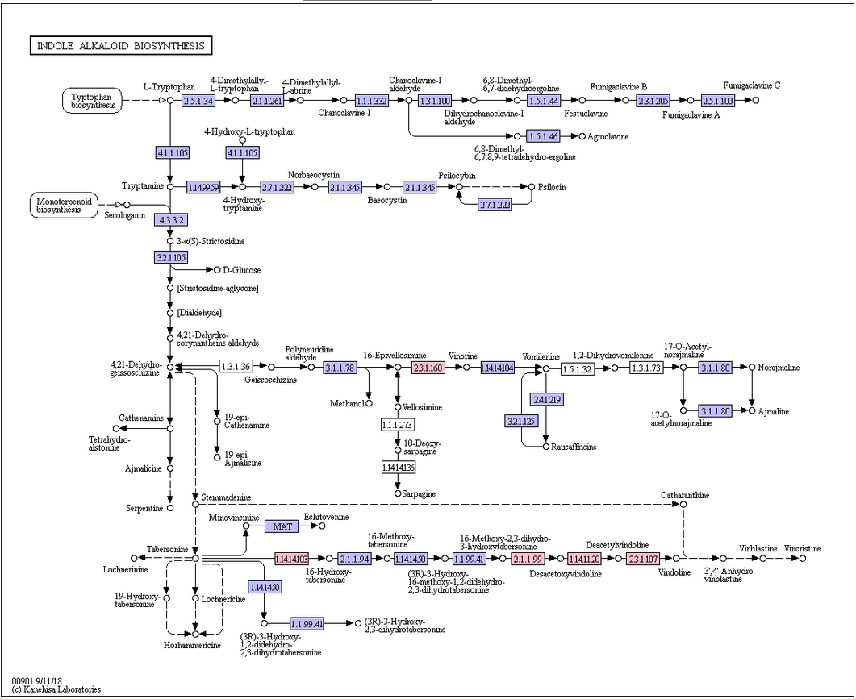
Indole Alkaloid Biosynthesis pathway
MJ
Notes:
Only found in methyl-jasmonate

Slide 12
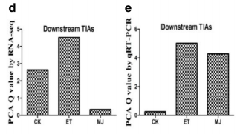
Discussion/conclusion
Forward reads
2 replicates for the control treatment
Blasting the differentially expressed transcripts to only SwissProt
Blast selection
Up-regulated/down-regulated
Difference TIA expression with Pan et al.
Root/stem/leaf replicates
TIA, MIA and Indole Alkaloid Biosynthesis pathways genes are more sensitive for MJ treatment than ET according to our research
Notes:
Due to missing of one reverse read, we decided to only use forward reads. However, using paired end reads could give more reliable results.
2 replicates: PCA shows a lot of difference between CK3 and other CK’s, seems closer to ET samples. Probably mislabelled, but not 100% sure so we left it out. By removing it, we also found a lot more significantly differentially expressed genes, strengthening our hypothesis that CK3 is wrong and causes a lot of noise.
We blasted the differentially expressed transcripts to the SwissProt database, which contains only manually annotated enzymes. Pan et al. did a blast to the nr database. They seemed to have more enzymes in pathways to be up-/down-regulated than our results. Further research.
We took only the top hit per blast query, but we noticed that if we would take more hits the coverage of pathways might be higher. This wouldn’t make our results more reliable. Further research.
During our research, we have not made a distinction between the up- or down-regulation of genes. This is important to understand the results of the pathways that are affected by MJ and ET.
In research of Pan et al. they concluded that the TIA downstream pathway genes are more sensitive to ET than to MJ. Our pathway enrichment analysis shows that MJ is the factor that influences expression of TIA pathway genes.
After some time doing our research, we noticed in the Pan et al. paper they actually did not use replicates per treatment of the same location in the plant, but they had per treatment a replicate of either root/stem/leaf tissue. This might have caused the difference of differentially expressed genes between replicates in our result.

Slide 13
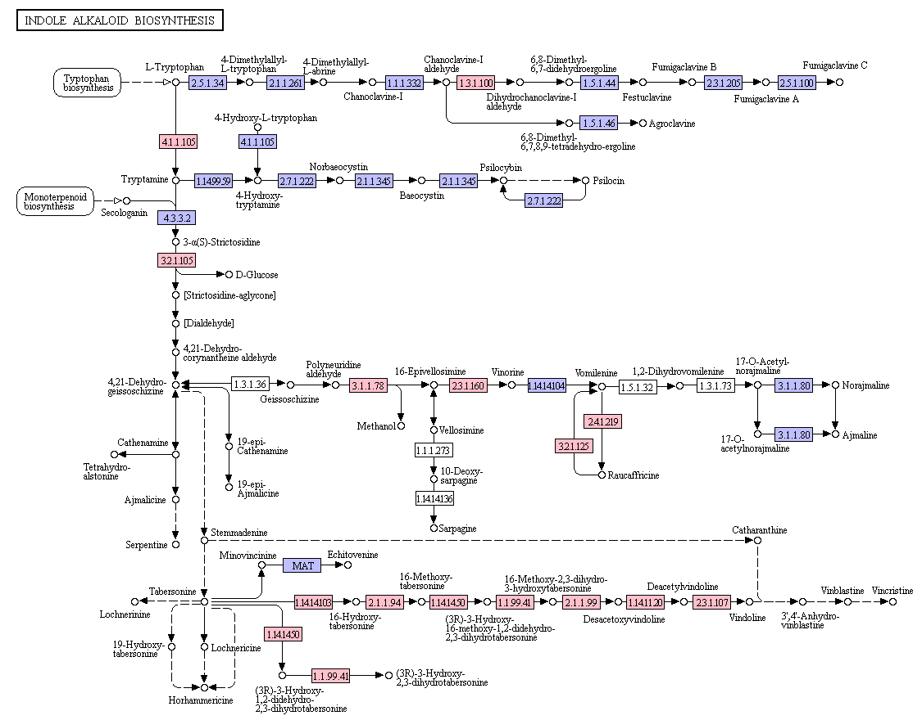
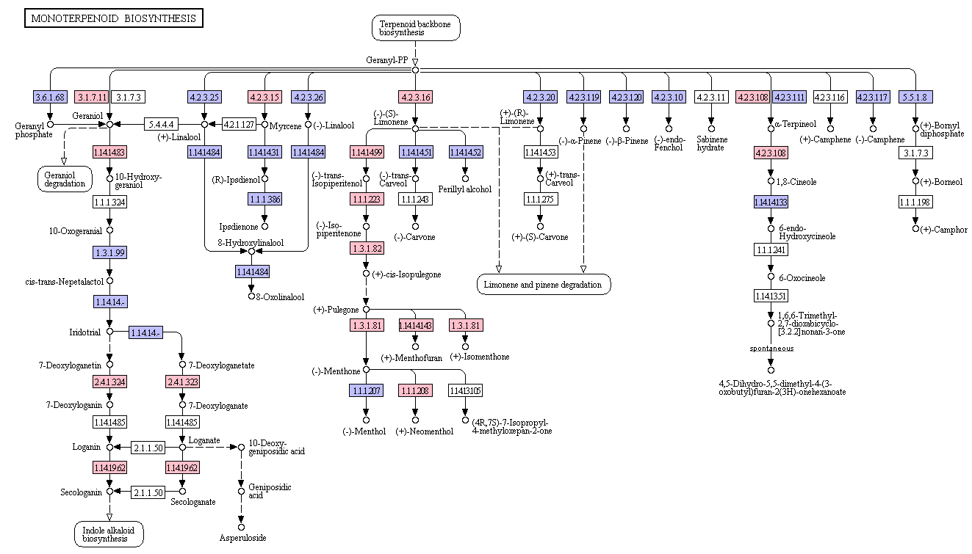
Unfiltered results
MJ
Notes:
Our results are based on only the top hits from BLAST, provided they have an e-value less than 0.05. While these statistically seem the most significant, we can’t say they are for sure, especially since a lot of the genes in the monoterpenoid and indole alkaloid pathways seem to have a match in the unfiltered results (red boxes). For further research, a scientist who has extensive experience with these pathways could perform manual curation on the hits to identify the biologically most probable match to increase pathway annotation.

Slide 14
References
Conesa, A., Madrigal, P., Tarazona, S., Gomez-Cabrero, D., Cervera, A., McPherson, A., ... & Mortazavi, A. (2016). A survey of best practices for RNA-seq data analysis. Genome biology, 17(1), 13.
Franke, J., Kim, J., Hamilton, J. P., Zhao, D., Pham, G. M., Wiegert‐Rininger, K., ... & Buell, C. R. (2018). Gene Discovery in Gelsemium Highlights Conserved Gene Clusters in Monoterpene Indole Alkaloid Biosynthesis. ChemBioChem.
Pan, Y. J., Lin, Y. C., Yu, B. F., Zu, Y. G., Yu, F., & Tang, Z. H. (2018). Transcriptomics comparison reveals the diversity of ethylene and methyl-jasmonate in roles of TIA metabolism in Catharanthus roseus. BMC genomics, 19(1), 508.

